Slide 1
Machine Learning Linear Regression Logistic Regression Support Vector Machines
Francesco Pugliese, PhD
neural1977@gmail.com

Slide 2
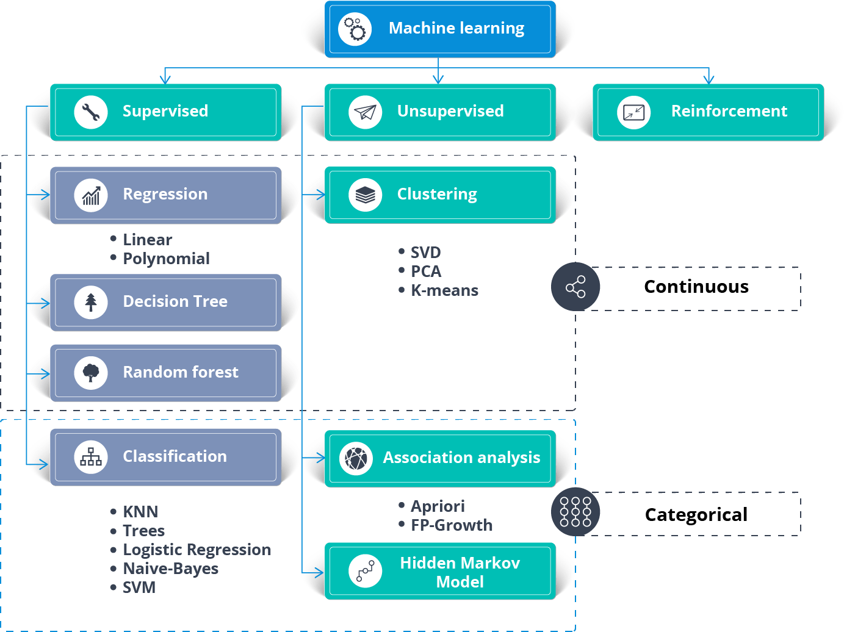
Classificazione degli Algoritmi di Machine Learning

Slide 3
Regressione Lineare
La regressione Lineare è un'analisi predittiva di base e molto utilizzata.
Le domande sottostanti la Regressione Lineare sono:
(1) può un insieme di variabili predittive fare un buon
lavoro nel predire una risultante variabile dipendente?
(2) Quali variabili in particolare sono predittori significative per la variabile dipendente risultante?
Queste stime di regression sono usate per spiegare la reThese regression estimates are used to explain the relationship between one dependent variable and one or more independent variables.

Slide 4
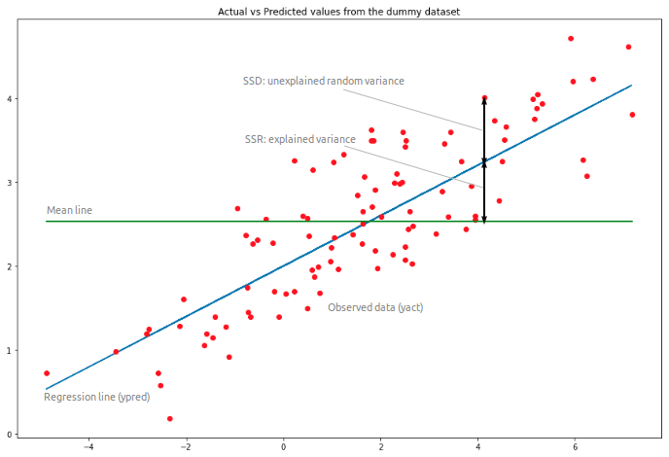
Linear Regression

Slide 5
Linear Regression
It is a machine learning algorithm based on supervised learning.
Models the relationship between a dependent variable and one or more independent variables.
Mainly used when working with scalar and exploratory variables.
Linear Regression finds its application to determine the extent to which there exists a linear relationship between a dependent variable (scalar) and one or more independent variables (exploratory).
A single independent variable is used to predict the value of a dependent variable.

Slide 6

Linear Regression
The simplest form of the regression equation with one dependent and one independent variable is defined by the formula y = c + b*x, which is a line (y = estimated dependent variable score, c = constant, b = regression coefficient, and x = score on the independent variable).
Hypothesis function is, as its meaning states, our prediction of how the final curve after the process of regression will look like. In the case of linear regression with one variable it looks like:
In the case of Multivariate Linear Regression we have:

Slide 7
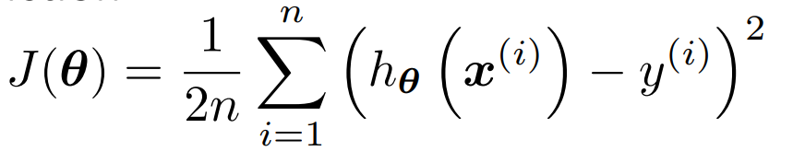
Linear Regression
‘x’ is or are the independent variable on which the hypothesis depends. 2. ‘Theta’ are the model parameters, 0 is our bias variable and 1 is our weight variable.
Loss Function is any equation which gives us an idea of how close we are to the required hypothesis. Higher the loss (or cost) function, farther are we from the required curve, and viceversa. Thus, this is the measure we are willing to minimize to implicitly reduce the error. A typical Mean Squared Error cost function looks like this:

Slide 8
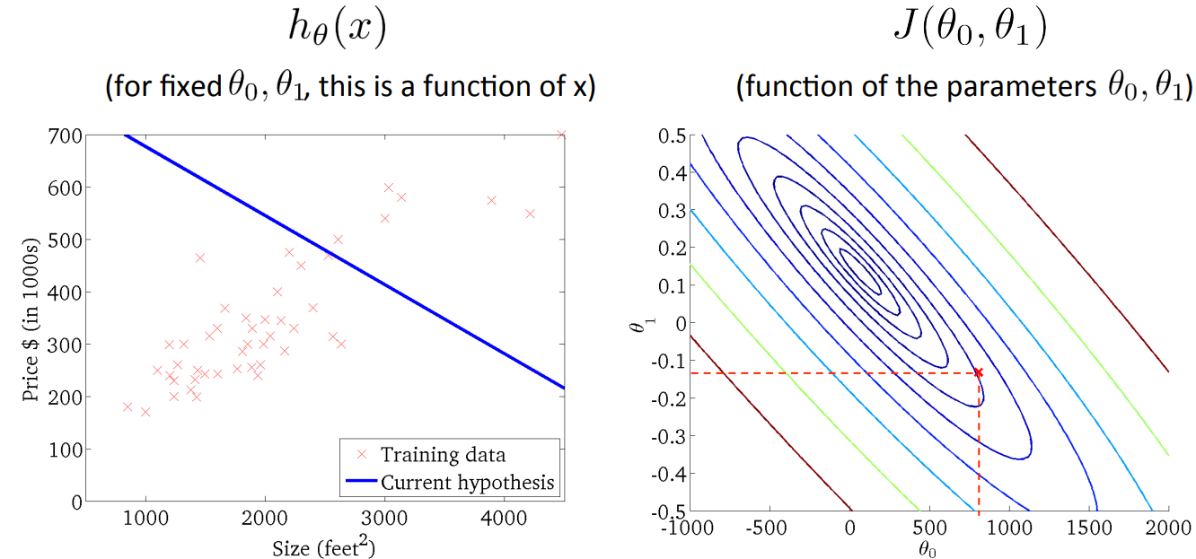
Linear Regression: Gradient Descent

Slide 9
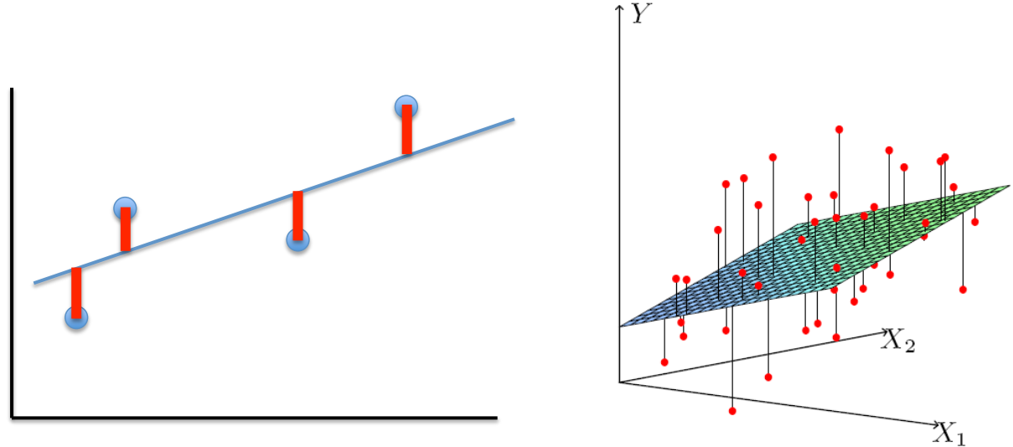
Linear Regression: Gradient Descent
The constant 1/2m is introduced so as to induce a basic normalization to the cost function value based on the number of entries and also to make it look pretty (2 and the 1/2 get cancelled when we differentiate J.

Slide 10
Linear Regression: Gradient Descent

Slide 11
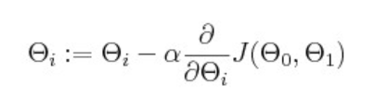
Linear Regression: Gradient Descent
Gradient Descent is a method by which we shall minimize the loss(Cost function). It is an optimization function that changes the values of theta 0 and theta 1 based on the slope of the cost function curve at that point. The changes in theta 0 and theta 1 represent changes on our hypothesis so as to get a better fit to the given data. We accomplish the task by applying this formula:
Where alpha is the Learning Rate

Slide 12
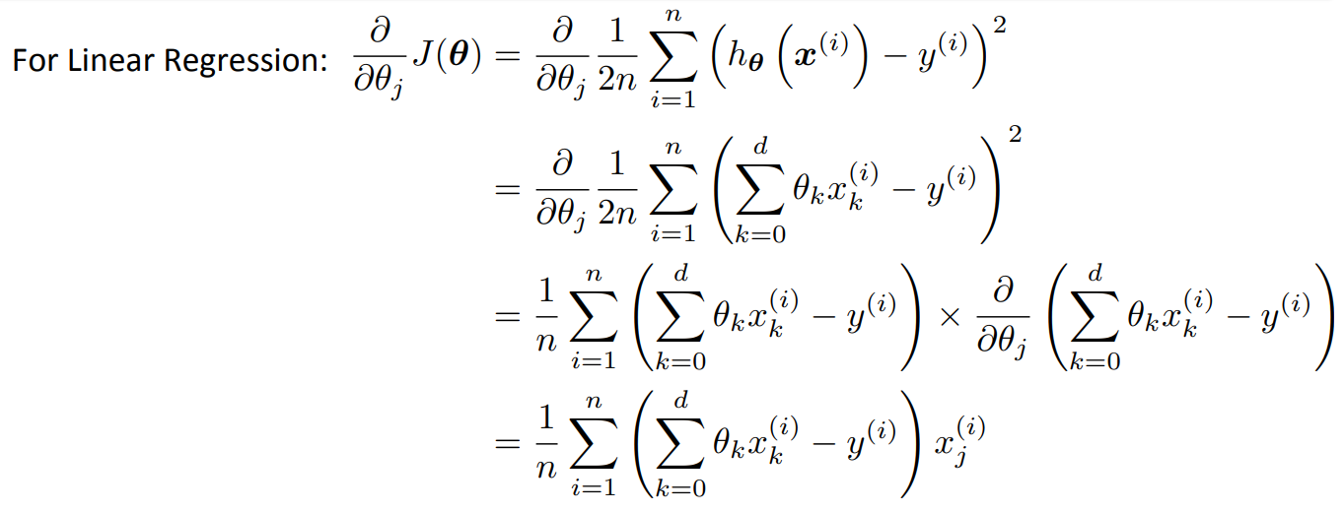
Linear Regression: Gradient Descent

Slide 13

Linear Regression: Steps of Gradient Descent
Initialize the parameters Theta
Repeat until convergence:
3) Convergence is achieved when the L2 norm:

Slide 14
Applications of Linear Regression
Risk Management in financial services or insurance domain
Predictive Analytics
Econometric
Epidemiology
Weather data analysis
Customer survey results analysis

Slide 15
Logistic Regression
The Logistic Regression algorithm determines what class a new input should fall into, that’s why Y is a discrete value.
Classification problems
Email -> spam/not spam?
Online transactions -> fraudulent?
Tumor -> Malignant/benign
Variable in these problems is YY is either 0 or 1
0 = negative class (absence of something)
1 = positive class (presence of something)
Let’s start with binary class problems. We can always implement a multiclass classification problem, which is an extension of the binary classification

Slide 16
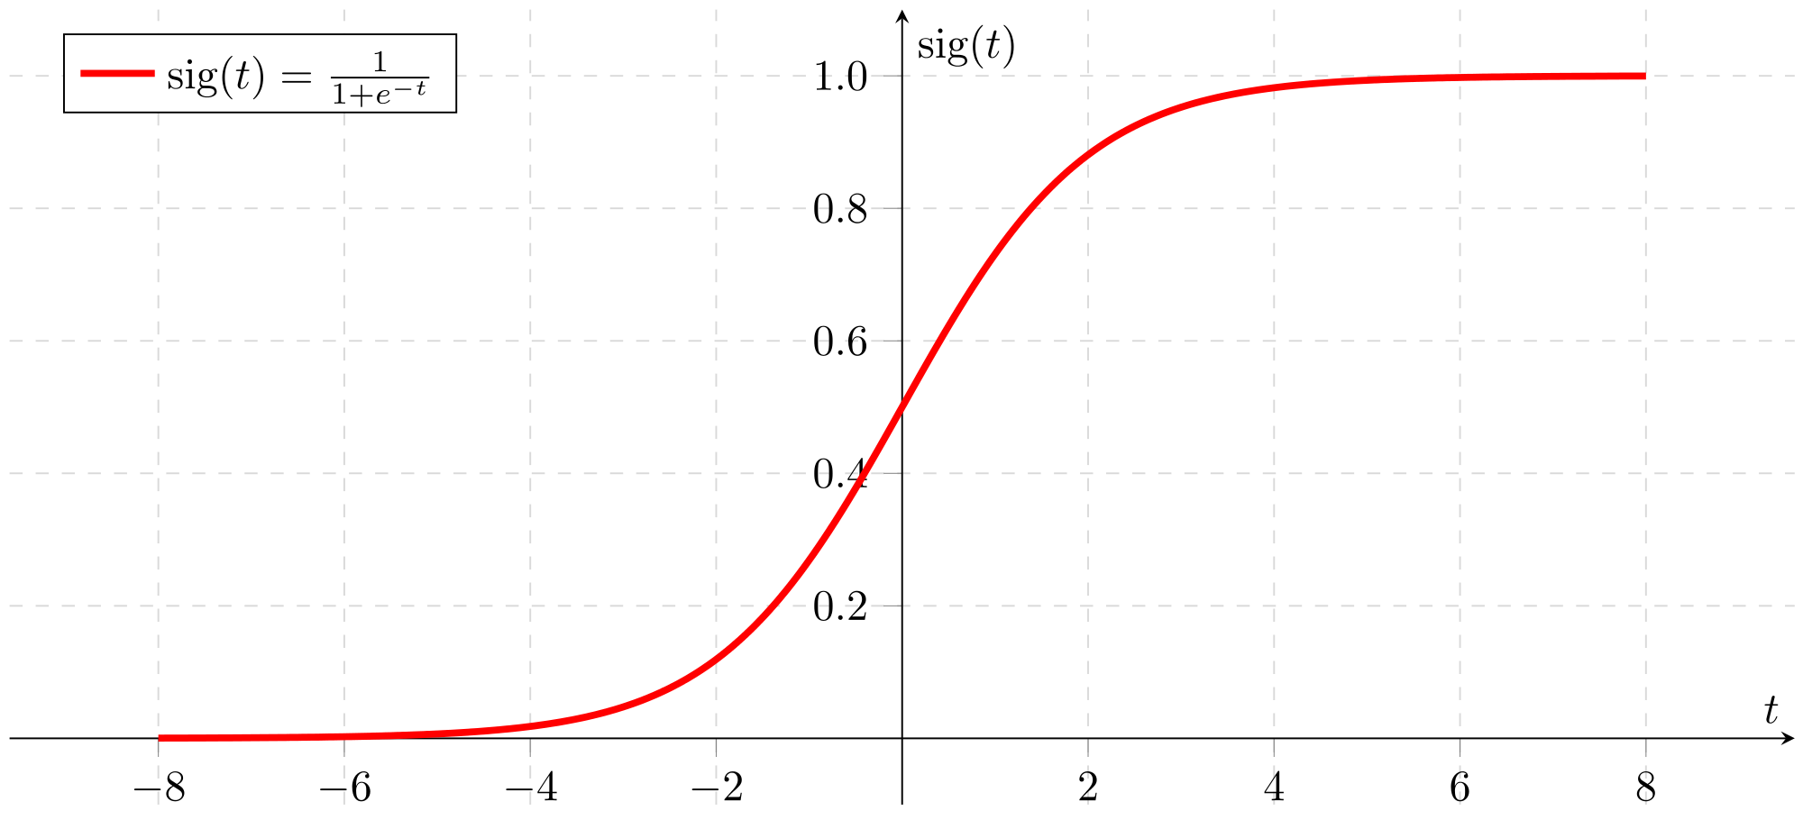
Logistic Regression
Logistic Regression predicts the probability of occurrence of a binary event utilizing a sigmoid function.

Slide 17
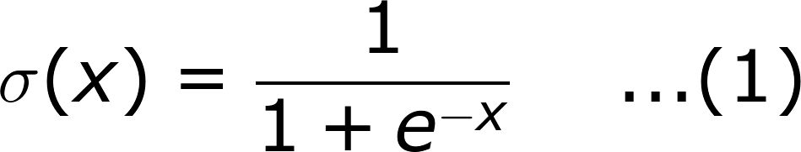
When to use Logistic Regression ?
It is a special case of linear regression where the target variable is categorical in nature. It uses a log of odds as the dependent variable.
The sigmoid function, also called the logistic function, gives an ‘S’ shaped curve that can take any real-valued number and map it into a value between 0 and 1.
If the curve goes to positive infinity, y predicted will become 1
If the curve goes to negative infinity, y predicted will become 0
If the output of the sigmoid function is more than 0.5, we can classify the outcome as 1 or YES, and if it is less than 0.5, we can classify it like 0 or NO
If the output is 0.75, we can say in terms of probability as: There is a 75 percent chance that patient will suffer from cancer.

Slide 18
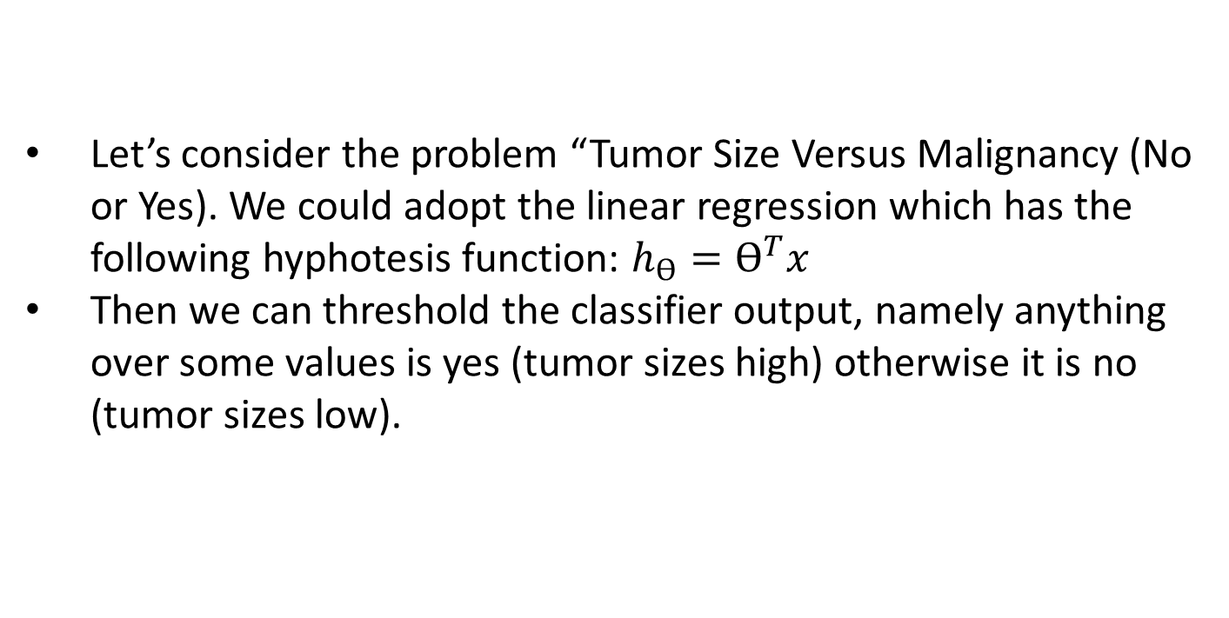

Let’s consider the problem “Tumor Size Versus Malignancy (No or Yes). We could adopt the linear regression which has the following hyphotesis function: $h_{ϴ}=ϴ^{T}x$
Then we can threshold the classifier output, namely anything over some values is yes (tumor sizes high) otherwise it is no (tumor sizes low).
Logistic Regression
Malignant
$$h_{ϴ}=ϴ^{T}x$$
(X)
XXXXX
0.5
What if we had a single Yes with a very small tumor?
OOOOO
Tumor Size

Slide 19
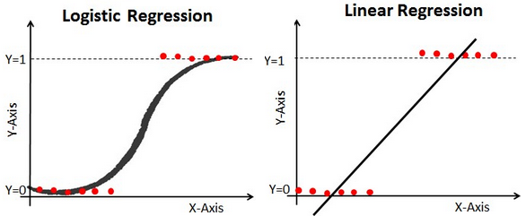
We can see previously above this does a reasonable job of stratifying the data points into one of two classes but in some cases we might have some yes classified as nos !!!.
By using a linear regression with threshold We might have small tumors classified as NO!! Moreover, with linear regression, output values van be larger than 1 or less than 0
Logistic Regression
Instead, we need to generate a value that is alway either 0 or 1. This is ccalled a «Classification problem».

Slide 20
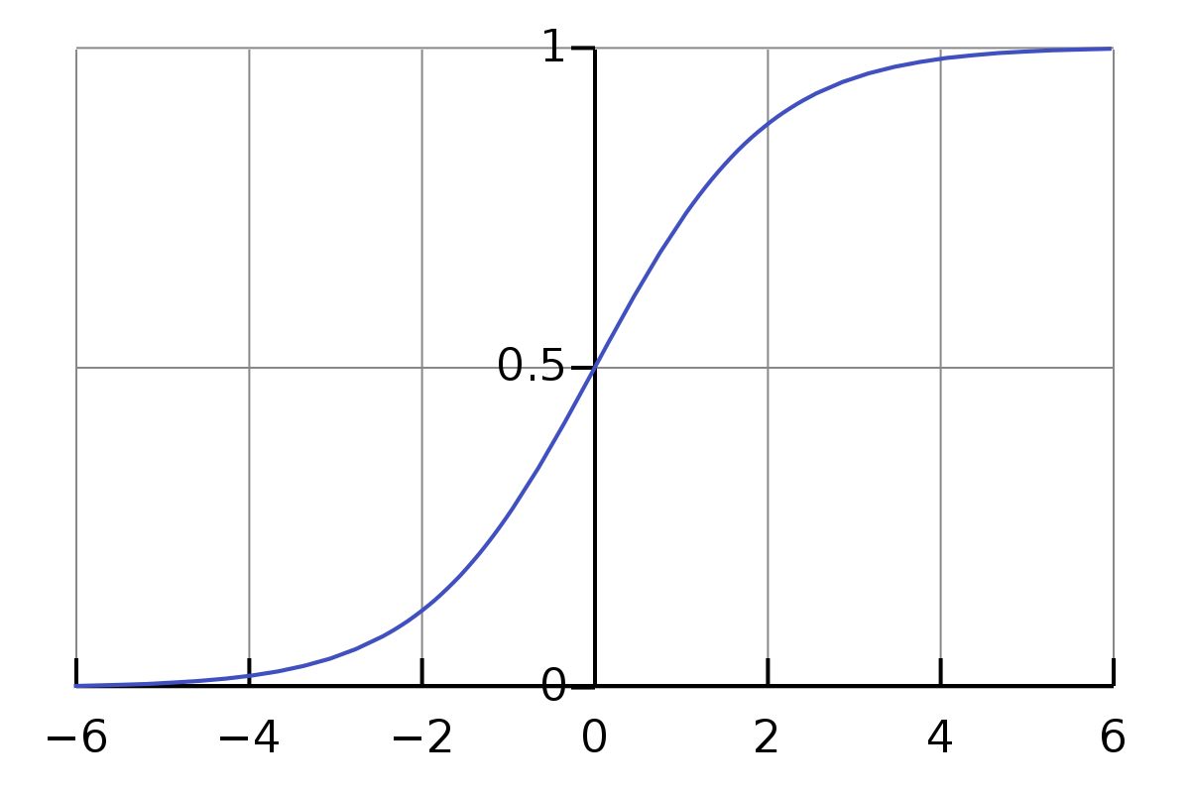
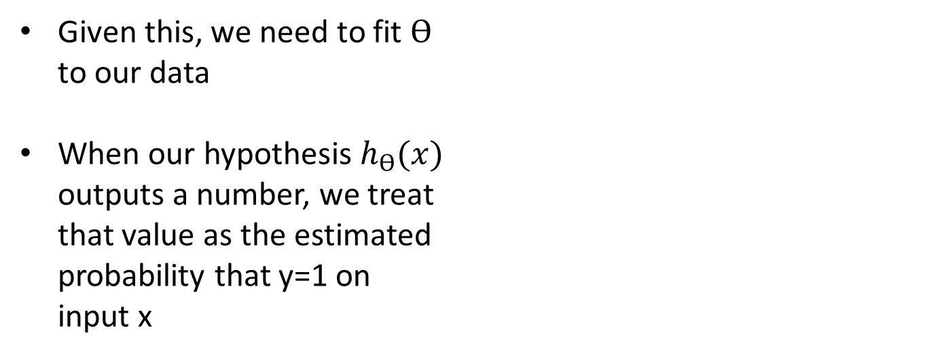
Logistic Regression: Hypothesis function
Sigmoid function looks like a curve that crosses 0.5 at the origin, then flattens out asymptotically at 0 and 1.
Given this, we need to fit $ϴ$
to our data
When our hypothesis $h_{ϴ}(x)$
outputs a number, we treat
that value as the estimated
probability that y=1 on
input x

Slide 21
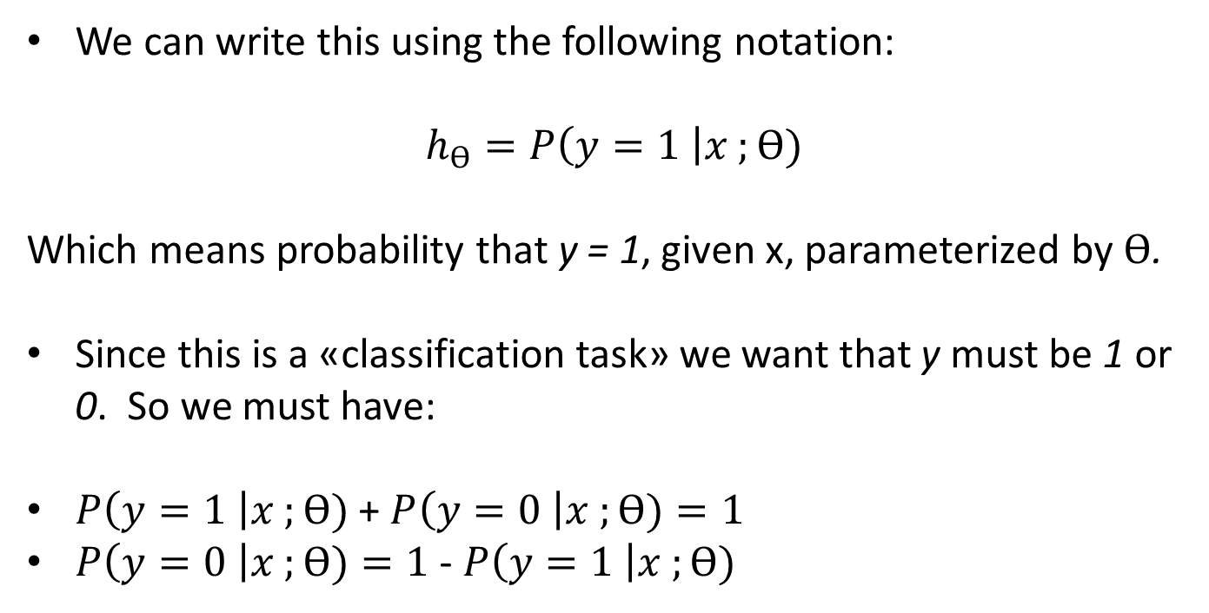
Logistic Regression: Hypothesis function
We can write this using the following notation:
$$h_{ϴ}=P\left(y=1 \right|x ;ϴ)$$
Which means probability that y = 1, given x, parameterized by $ϴ$.
Since this is a «classification task» we want that y must be 1 or 0. So we must have:
$P\left(y=1 \right|x ;ϴ)$+ $P\left(y=0 \right|x ;ϴ)=1$
$P\left(y=0 \right|x ;ϴ)=1$ - $P\left(y=1 \right|x ;ϴ)$

Slide 22
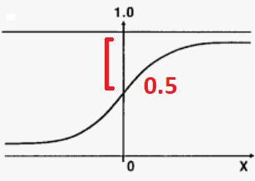
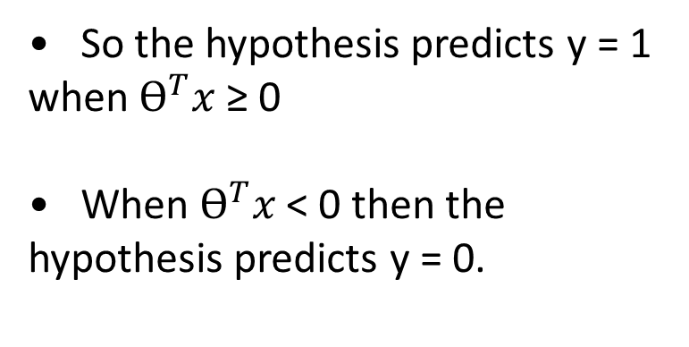
One way of using the sigmoid function is:
1) When the probability of y being 1 is greater than 0.5 then we can predict y = 1
2) Else we predict y = 0
Logistic Regression: Decision Boundary
So the hypothesis predicts y = 1 when $ϴ^{T}x$ ≥ 0
When $ϴ^{T}x$ < 0 then the hypothesis predicts y = 0.

Slide 23
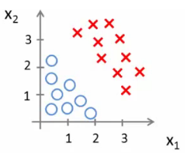
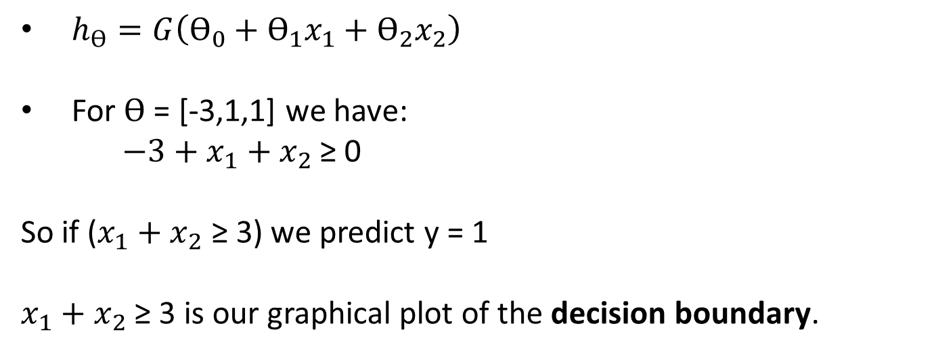
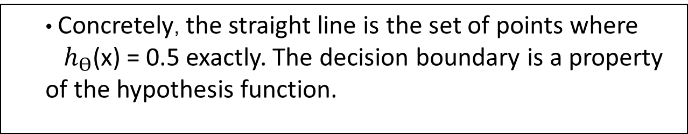
Logistic Regression: Decision Boundary
$h_{ϴ}=G\left(ϴ_{0}+ϴ_{1}x_{1}+ϴ_{2}x_{2}\right)$
For $ϴ$ = [-3,1,1] we have:
$−3+x_{1}+x_{2}$ ≥ 0
So if ($x_{1}+x_{2}$ ≥ 3) we predict y = 1
$x_{1}+x_{2}$ ≥ 3 is our graphical plot of the decision boundary.
Concretely, the straight line is the set of points where
$h_{ϴ}$(x) = 0.5 exactly. The decision boundary is a property of the hypothesis function.

Slide 24
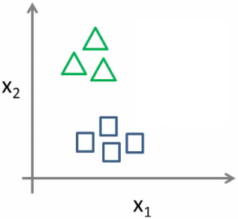
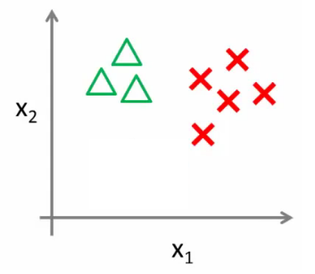
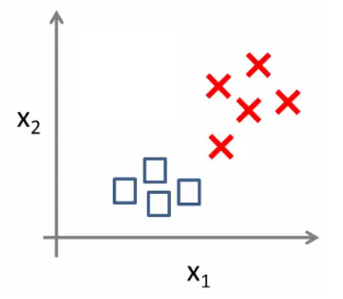




Logistic Regression: Multiclass Classification Problem
We split the training set into three separate binary classification problems.
$${h_{ϴ}}^{(1)} (x)$$
$${h_{ϴ}}^{(2)} (x)$$
$${h_{ϴ}}^{(3)} (x)$$
Train a logistic regression classifier for each class i in order to predict the probability that y = 1
On a new input, x to make a prediction, pick the class i that maximizes the probability that
$${h_{ϴ}}^{(i)} (x)$$

Slide 25
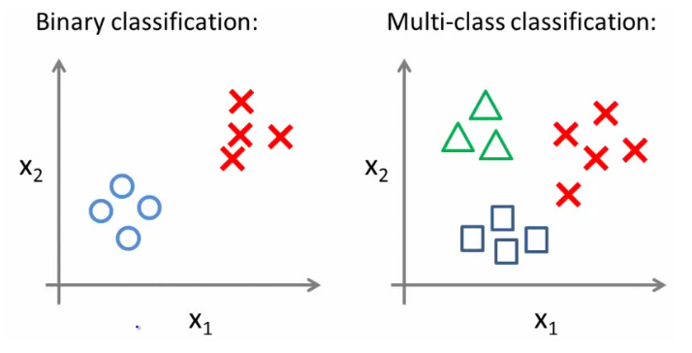
Logistic Regression: Multiclass Classification Problem
We adopt a one vs. all classification that makes a binary classification work for a multi-class classification.

Slide 26
Logistic Regression
Logistic Regression is used when the dependent variable is binary.
It is a go-to method for binary classification problems in statistics.
First, it is quintessential to understand when to use linear regression and when to use logistic regression.
Linear vs Logistic regression –
Linear regression is used when the dependent variable is continuous and the nature of the regression line is linear.
Logistic regression is used when the dependent variable is binary in nature.

Slide 27
Applications of Logistic Regression
Cancer Detection
Trauma and Injury Severity Score
Image Segmentation and Categorization
Geographic Image Processing
Handwriting recognition
Prediction whether a person is depressed based on bag of words from the corpus

Slide 28
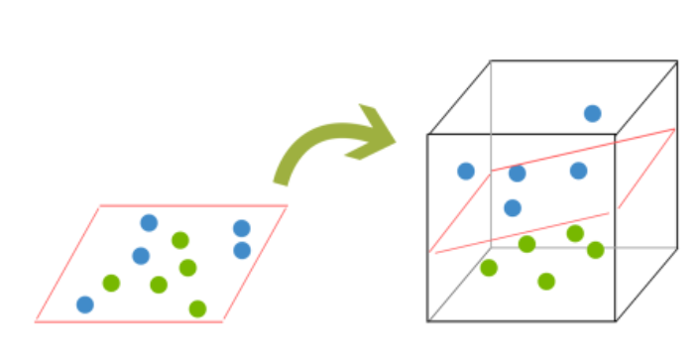
SUPPORT VECTOR MACHINES (SVMs)
A Support Vector Machine (SVM) is a supervised machine learning algorithm that can be employed for both classification and regression purposes.
THE PROBLEM OF DIVIDING THE DATASET INTO TWO OR MORE CLASSES

Slide 29
Support Vector Machines
Create a line or a hyperplane which separates the data into multiple classes.
Is a supervised machine learning algorithm which can be used for both classification or regression challenges. However, it is mostly used in classification problems.
Transforms your data base on it, finds an optimal boundary between the possible outputs.
Performs classification by finding the hyperplane that maximizes the margin between the two classes. The vectors that define the hyperplane are called the support vectors.
The SVM Algorithm:
Define an optimal hyperplane with a maximized margin
Map data to a high dimensional space where it is easier to classify with linear decision surfaces
Reformulate problem so that data is mapped implicitly into this space

Slide 30
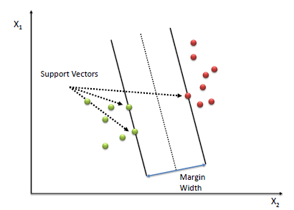
Support vector machines(SVM)

Slide 31
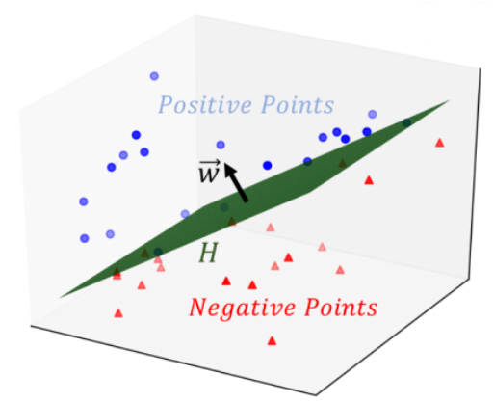
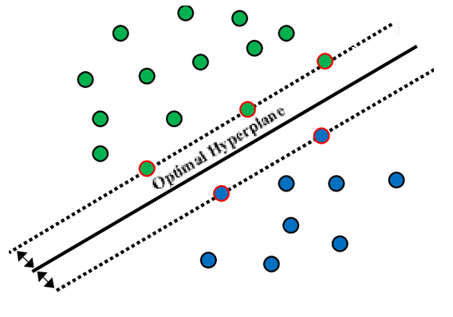
SUPPORT VECTOR MACHINES (SVMs)
SVMs are a machine learning model that is based on the idea of finding a hyperplane that best divides a dataset into two classes, as shown in the image below.
2D Case
3D Case

Slide 32
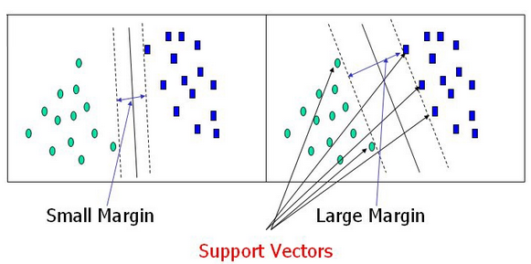
SUPPORT VECTOR MACHINES (SVMs)
Support Vectors are the data points nearest to the hyperplane, the points of a data set that, if removed, would alter the position of the dividing hyperplane. Because of this, they can be considered the critical elements of a data set..

Slide 33
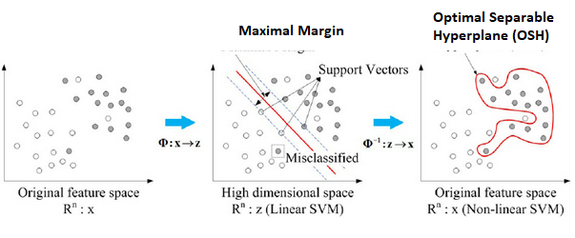
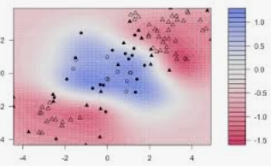
SUPPORT VECTOR MACHINES (SVMs)
Compared to both logistic regression and neural networks, a SVM sometimes gives a cleaner way of learning non-linear functions

Slide 34
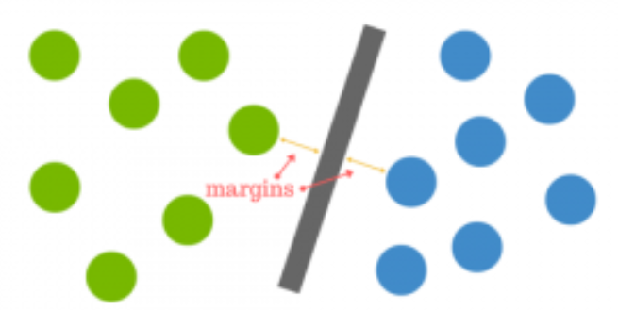
SUPPORT VECTOR MACHINES (SVMs)
Compared to both logistic regression and neural networks, a SVM sometimes gives a cleaner way of learning non-linear functions
The distance between the hy- perplane and the nearest data point from either set is known as the margin. The goal is to choose a hyperplane with the greatest possible margin between the hyperplane and any point within the training set, giving a greater chance of new data being classified correctly.

Slide 35
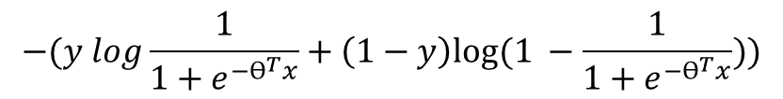
SVMs Loss Function
Alternative view of Logistic Regression. If we look at the loss (cost) function:
each example contributes a term like the one below to the overall cost function
For the overall cost function, we sum over all the training examples using the above function, and have a 1/m term. So we get:
$$−(y log{ h}_{ϴ}\left(x\right)+\left(1−y\right)log{(1− h}_{ϴ}\left(x\right)))$$
$$−(y log\frac{1}{1+e^{−ϴ^{T}x}}+\left(1−y\right)log⁡(1 −\frac{1}{1+e^{−ϴ^{T}x}}))$$

Slide 36
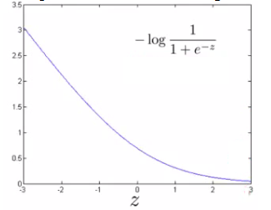
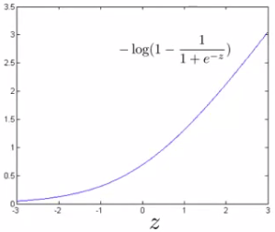
SVMs Loss Function
So each training example contributes that term to the cost function for logistic regression.
If y = 1 then only the first term in the objective matters. If we plot the functions vs. z we get the chart beside. If z is big, the cost is low and this is good!
But if z is 0 or negative the cost contribution is high.

Slide 37
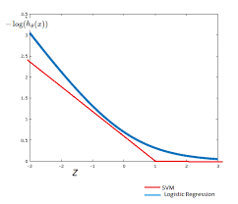
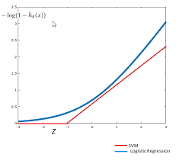
SVM Loss Function
Instead of a curved line we create two straight lines (red) which act as an approximation to the logistic regression y = 1 and y = 0 functions
So this is the new y=1 cost function that gives the SVM a computational advantage and an easier optimization problem. We call this function cost1(z). Equivalently we call the y=0 function as cost0(z).
Cost1
Cost0

Slide 38

SVM Loss Function
In Logistic Regression the Loss Function was:
With Support Verctor Machines the Loss Function now is:
There is the regularizer term still, but something must change.

Slide 39

SVM Loss Function
1. Get rid of the 1/m terms. This is just a slightly different convention
By removing 1/m we should get the same optimal values for 1/m is a
constant, so should get same optimization e.g. say you have a
minimization problem which minimizes to u = 5. If your cost function * by a constant, you still generates the minimal value. That minimal
value is different, but that's irrelevant.
2. For logistic regression we had two terms; Training data set term (i.e. that
we sum over m) = A. Regularization term (i.e. that we sum over n) = B. So we could describe it as A + λB. Need some way to deal with the trade-off between regularization and data set terms. Set different values for λ to parametrize this trade-off. Instead if parameterize- tion this as A + λB. For SVMs the convention is to use a different parameter called C. So do CA + B. If C were equal to 1/λ then the two functions (CA + B and A + λB) would give the same value.

Slide 40
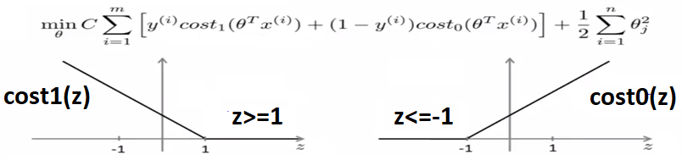
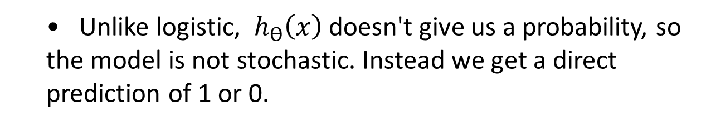
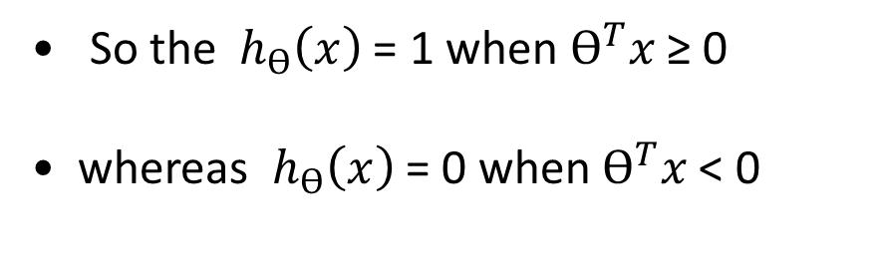
SVMs Hypothesis Function
Unlike logistic, ${ h}_{ϴ}\left(x\right)$ doesn't give us a probability, so the model is not stochastic. Instead we get a direct prediction of 1 or 0.
So the ${ h}_{ϴ}\left(x\right)$ = 1 when $ϴ^{T}x$ ≥ 0
whereas ${ h}_{ϴ}\left(x\right)$ = 0 when $ϴ^{T}x$ < 0

Slide 41
So this is the new y=1 cost function Gives the SVM a computational advantage and an easier optimization problem
We call this function cost₁(z)
If y = 0 then only the second term matters. Same as before, if z is small then the cost is low and viceversa.

Slide 42
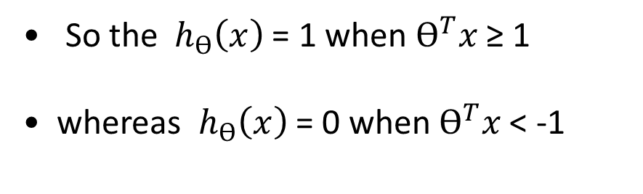
SVMs: Large Margin Intuition
Sometimes people refer to SVM as large margin classifiers.
So the ${ h}_{ϴ}\left(x\right)$ = 1 when $ϴ^{T}x$ ≥ 1
whereas ${ h}_{ϴ}\left(x\right)$ = 0 when $ϴ^{T}x$ < -1

Slide 43
Applications of SVM
Face detection — classify between face and non-face areas on images
Text and hypertext categorization
Classification of images
Bioinformatics — protein, genes, biological or cancer classification.
Handwriting recognition
Drug Discovery for Therapy
In recent times, SVM has played a very important role in cancer detection and its therapy with its
application in classification.

Slide 44
Francesco Pugliese

